Slide 1
Introduction to SQL Server Integration Services
CONFIDENTIAL
November 29, 2010

Slide 2




Topics Covered
Overview of DTS
Introduction to SSIS
What is SSIS
Pre – Requisites for Installation
Architecture of SSIS
Elements of SSIS
Features of SSIS
SSIS Controls
My First SSIS package
SSIS Package Deployment
SSIS Best Practices
References
- ‹#› -

Slide 3
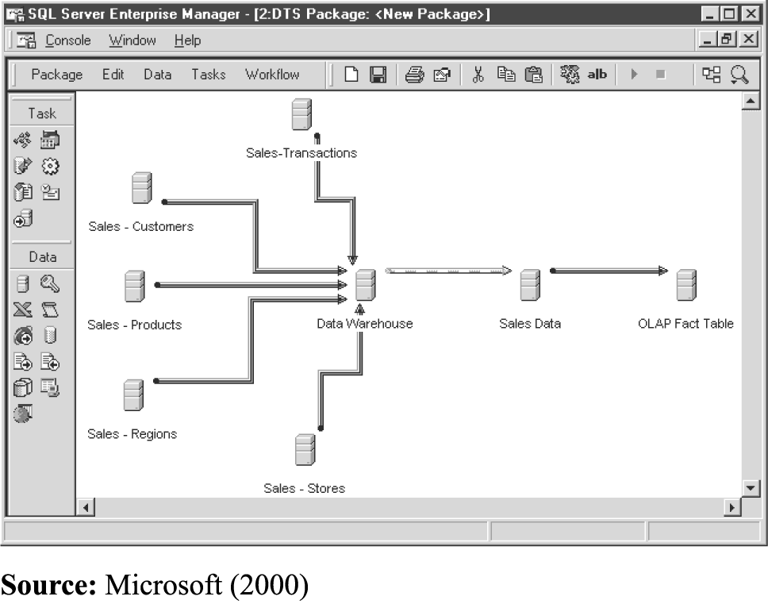
Data Transformation services – An Overview
It is also known as DTS, is a widely used tool designed to move data from one source to another.
It is an organized collection of connections, DTS tasks, DTS transformations, workflow constraints assembled either with a DTS tool or programmatically.
DTS primarily uses Data Pump Task that moves data from a single source to a single destination with some interim transformation logic
DTS focuses on the workflow features of the product
- ‹#› -

Slide 4
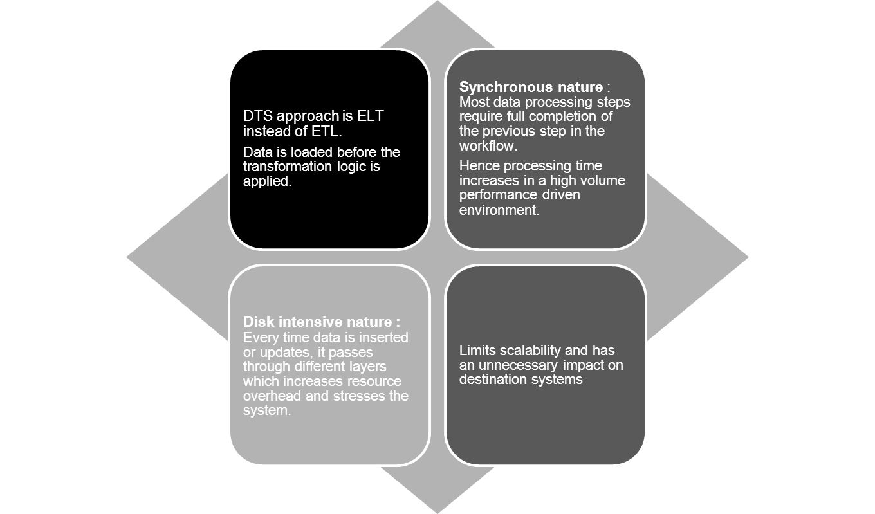
Data Transformation services – Limitations
- ‹#› -

Slide 5
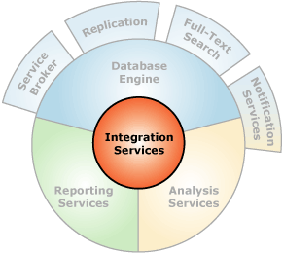
Introduction to SQL Server Integration Services (SSIS)
SQL Server Integration Services is a
Microsoft product which provides a platform
for building high performance data integration
solutions.
The concept of ETL forms the back bone for
SSIS, namely Extract (E), Transform (T) and
Load (L).
SSIS replaces DTS which was first introduced
as a part of SQL Server 7.0
SSIS forms one of main platforms of Business
Intelligence foundations.
- ‹#› -

Slide 6
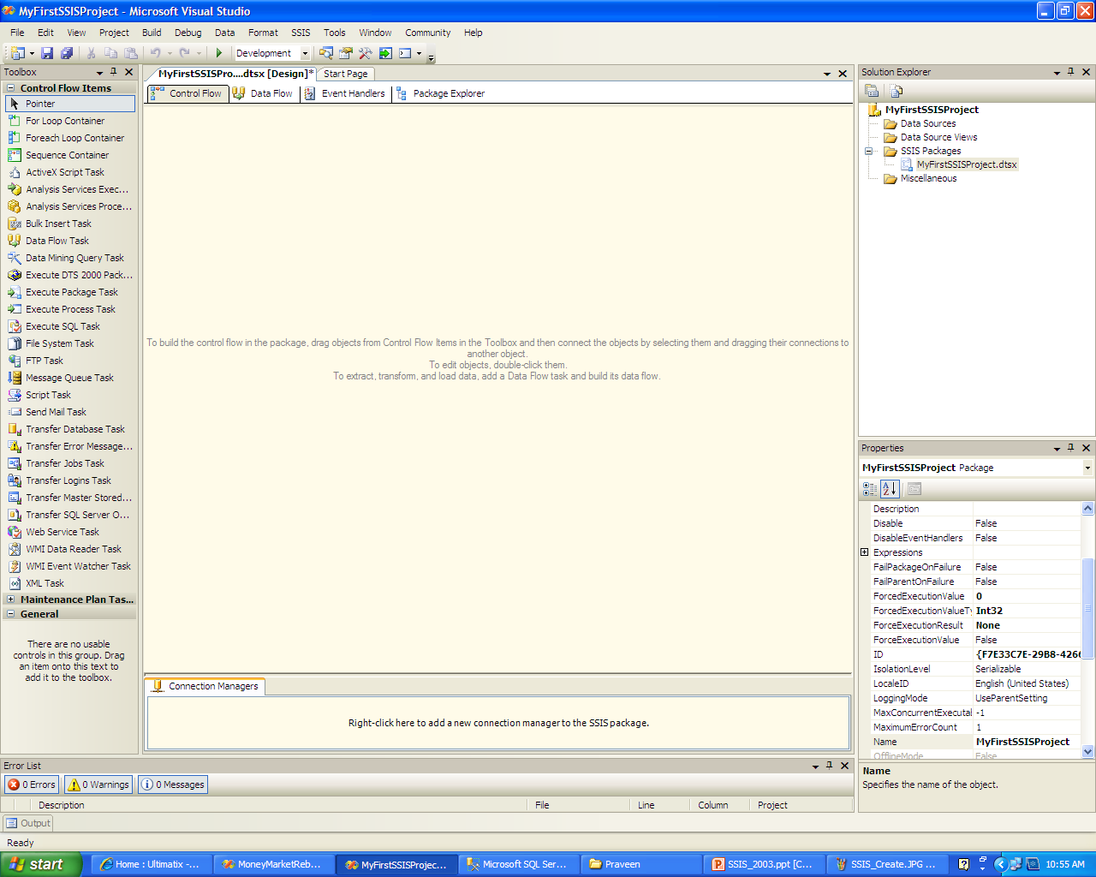

What is SSIS – an Understanding.
SSIS designer is a graphical tool which is used to develop and maintain SSIS packages.
SSIS designer has four permanent tabs namely : Control Flow, Data Flow, Event Handlers, Package Explorer
It also includes Connection Manager area to create connection to data sources
When a package is running, the progress/execution result tabs shows the execution of the package
- ‹#› -

Slide 7
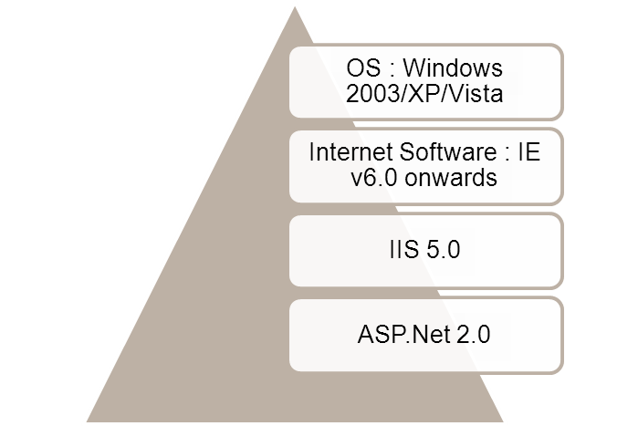
Installing SSIS
Requirement for installing SQL Server Integration Services
SSIS is installed as part of SQL Server installation. It is present as an installation component from SQLServer 2005 onwards
After installation, the following components are installed :
.Net Framework 2.0
SQL Server Native Client
SQL Server Setup support files
Once installation is done ensure that Integration service is running as part of Windows service
- ‹#› -

Slide 8
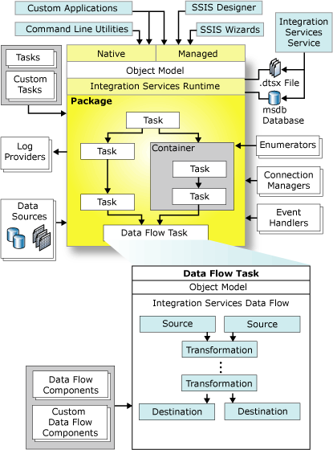

Architecture of SSIS
SSIS consists of four key parts :
the Integration Services service
the Integration Services Object Model
the Integration Services run time and run time executables
the Data Flow Engine which encapsulates the data flow
- ‹#› -

Slide 9

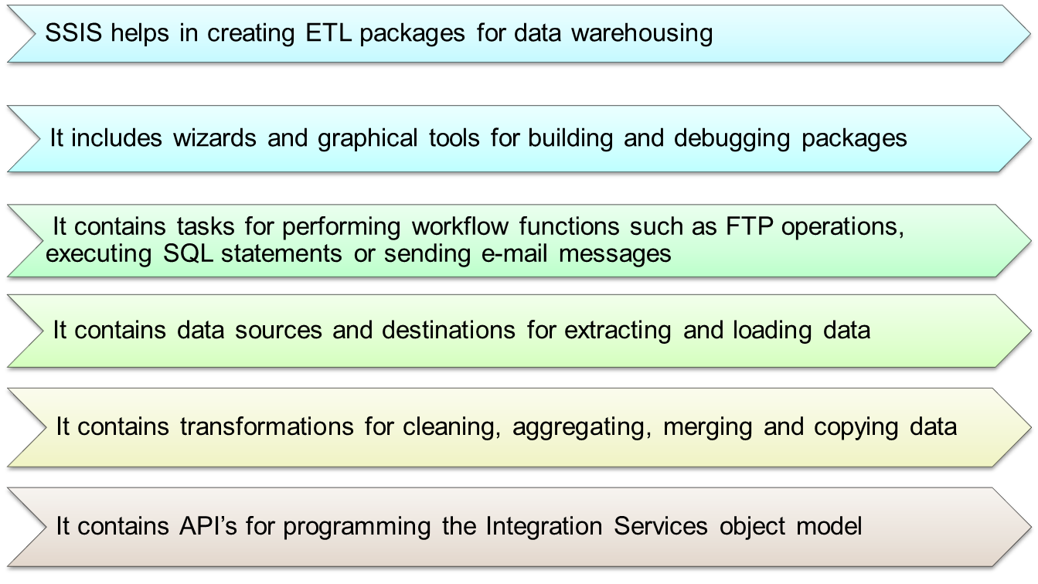
Features of SSIS
- ‹#› -

Slide 10
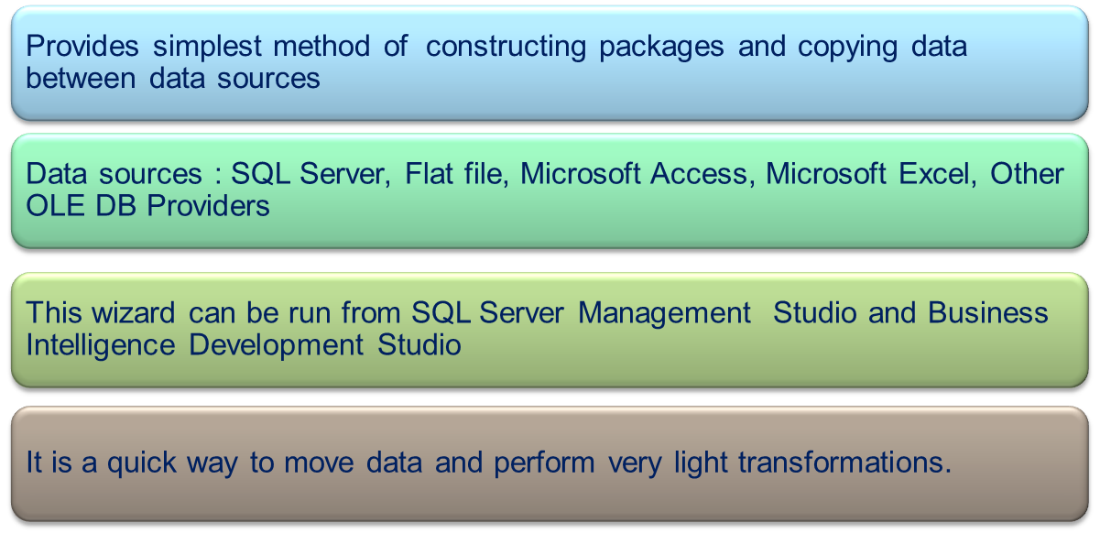
Elements of SSIS
1. Import and Export Wizard
- ‹#› -

Slide 11
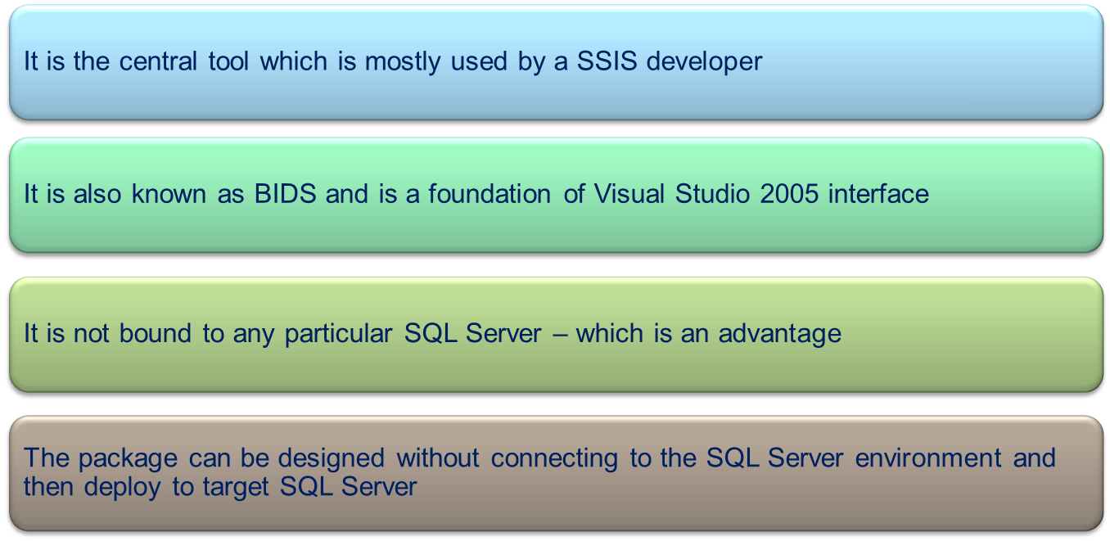
Elements of SSIS
2. Business Intelligence Development Studio
- ‹#› -

Slide 12
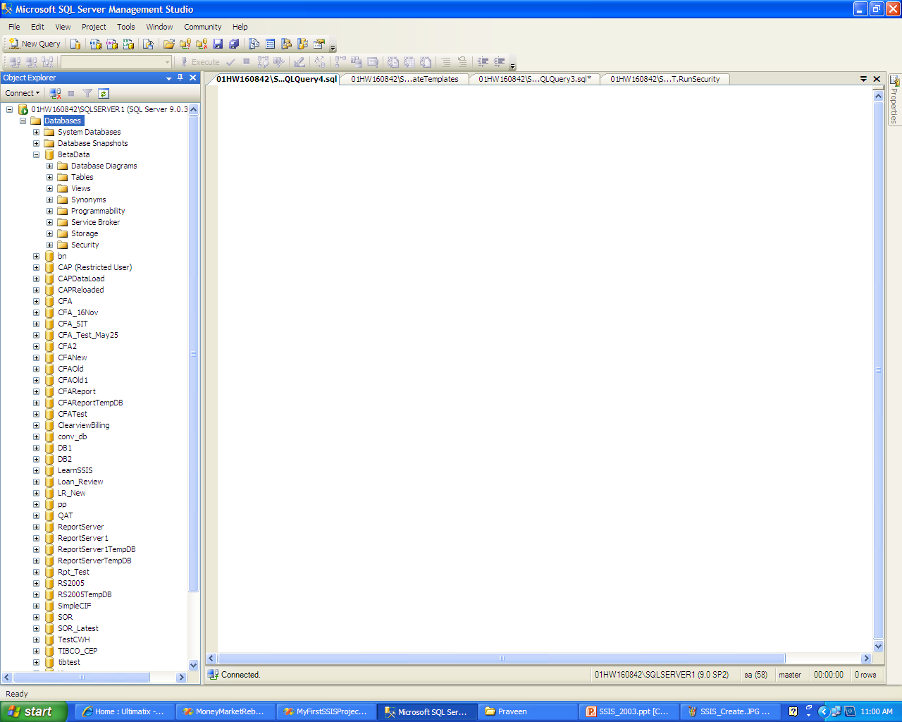
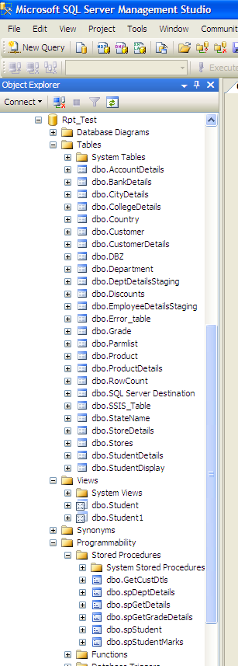
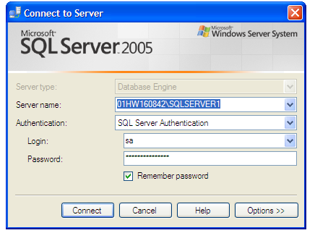
Elements of SSIS…. contd
2. Business Intelligence Development Studio
- ‹#› -

Slide 13
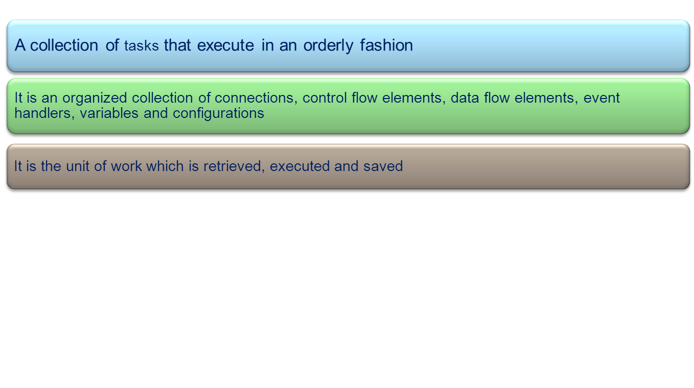
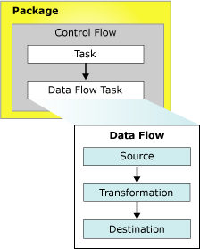
Elements of SSIS
3. Packages
- ‹#› -

Slide 14
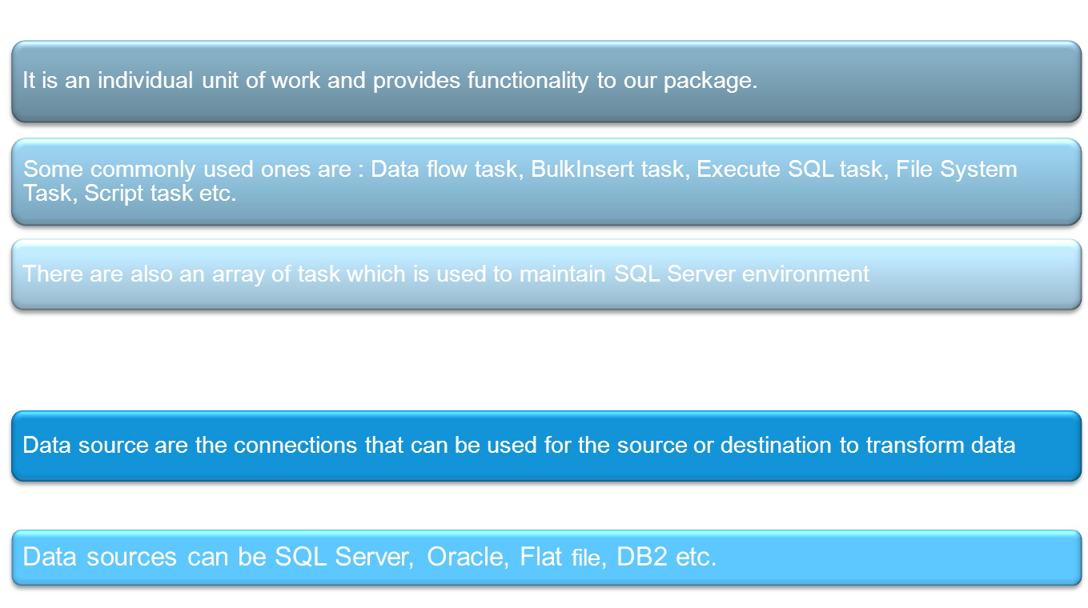
Elements of SSIS
4. Tasks
4. Data Source
- ‹#› -

Slide 15
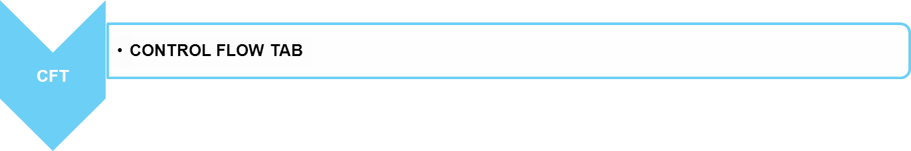
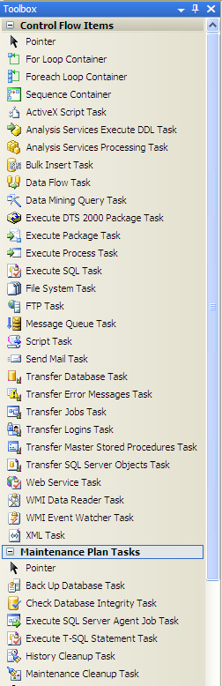
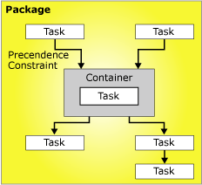
SSIS Controls
Provides three different types of control flow elements :
Containers that provides structure in packages
2. Tasks that provide functionality
3. Precedence constraints that connect the executables, containers and tasks into an ordered control flow.
- ‹#› -

Slide 16
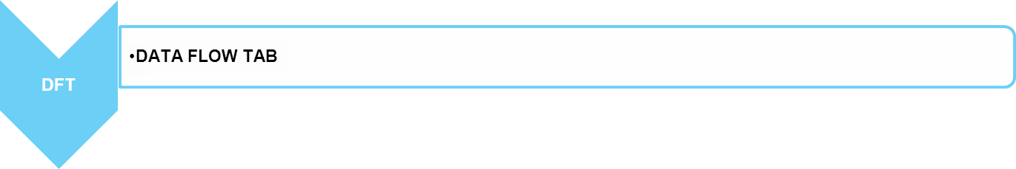
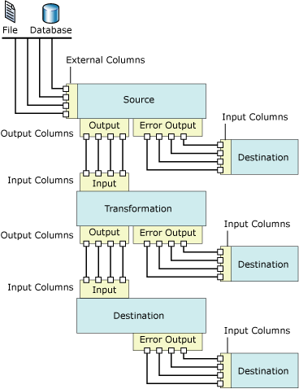
SSIS Controls
Provides three different types of data flow components : source, transformation, destination
Sources extract data from data stores such as tables and views
Transformations modify, summarize and clean data
Destinations load data into data stores.
- ‹#› -

Slide 17

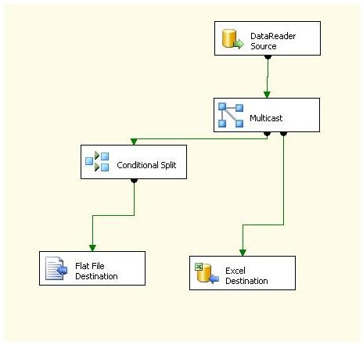
SSIS Controls
- ‹#› -

Slide 18
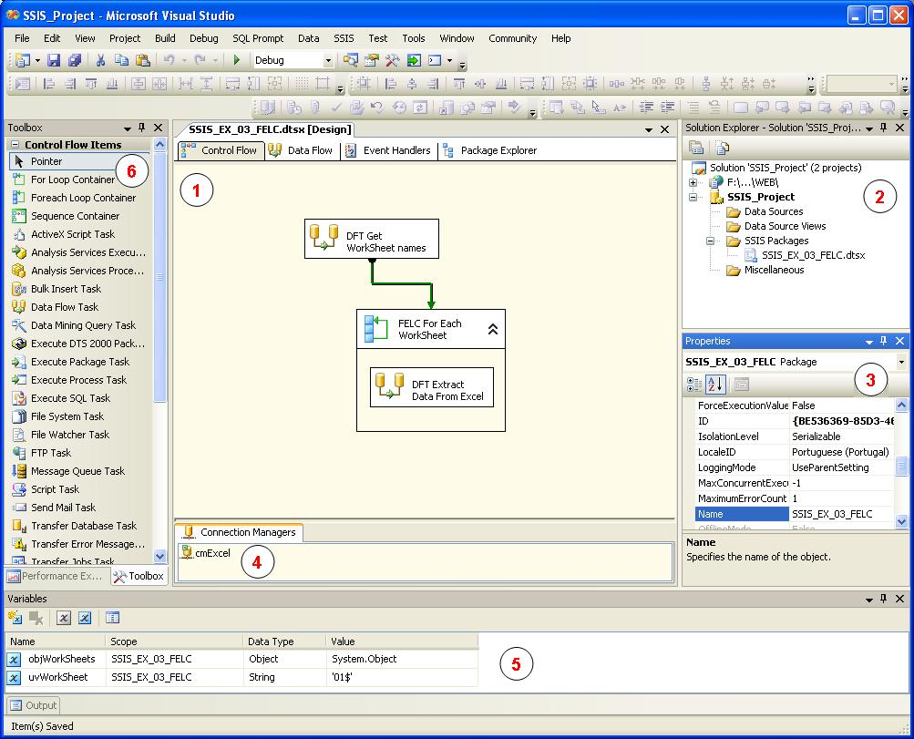
SSIS Designer – a snapshot
Let’s familiarize the SSIS IDE
- ‹#› -

Slide 19
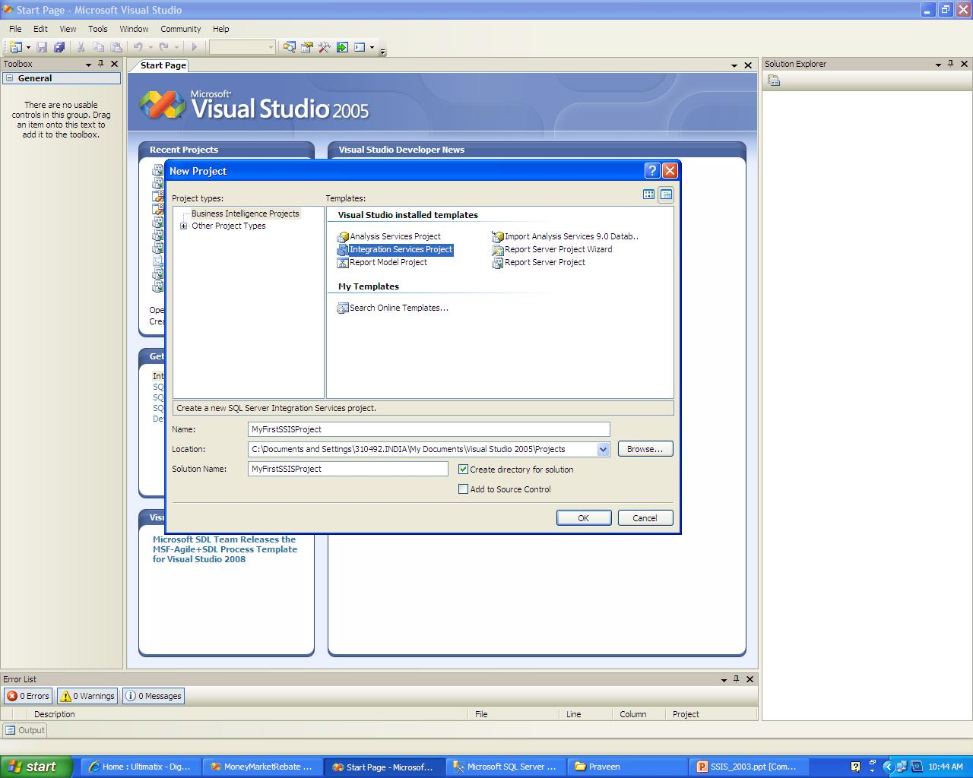
My First SSIS package
Open Visual Studio 2005.
From Menu bar ->File ->New Project -> Integration Services
Enter the project name and click open
- ‹#› -

Slide 20
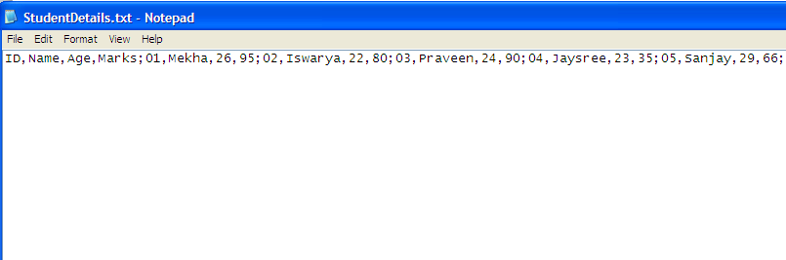
My First SSIS package … contd
Let us create a SSIS project to load data from a flat file to SQL Server DB. Include a new column “Result” in the dbo.StudentDetails table which will have values Pass or Fail based on the Marks column. Above 40 is considered Pass else Fail.
Source : Flat File -> StudentDetails.txt
Destination : SQL Server DB -> RPT_Test -> dbo.StudentDetails
- ‹#› -

Slide 21
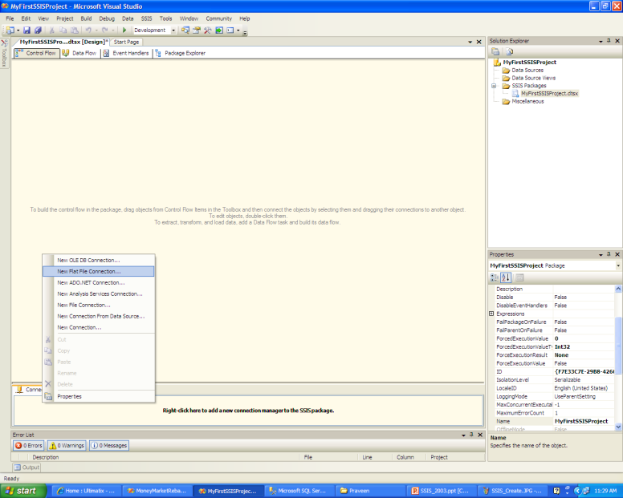
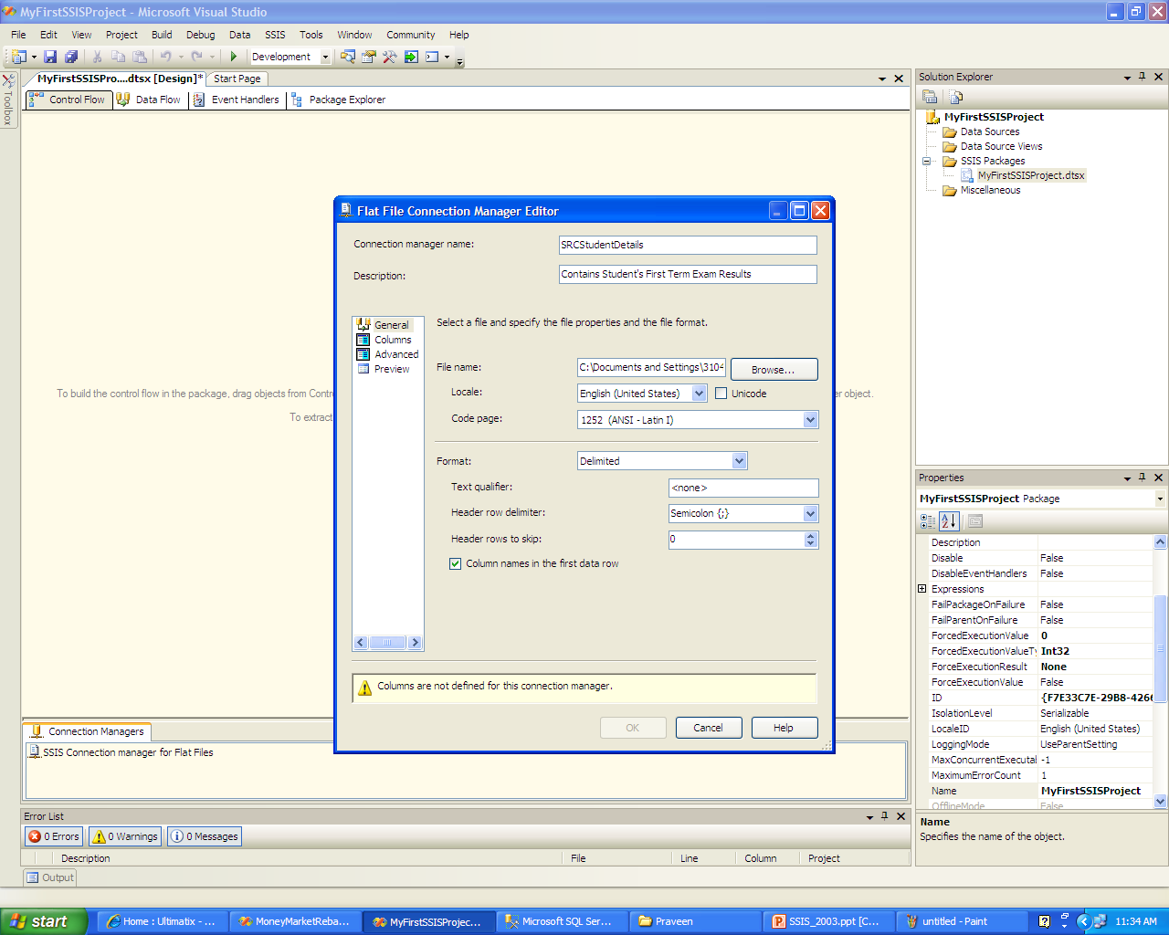
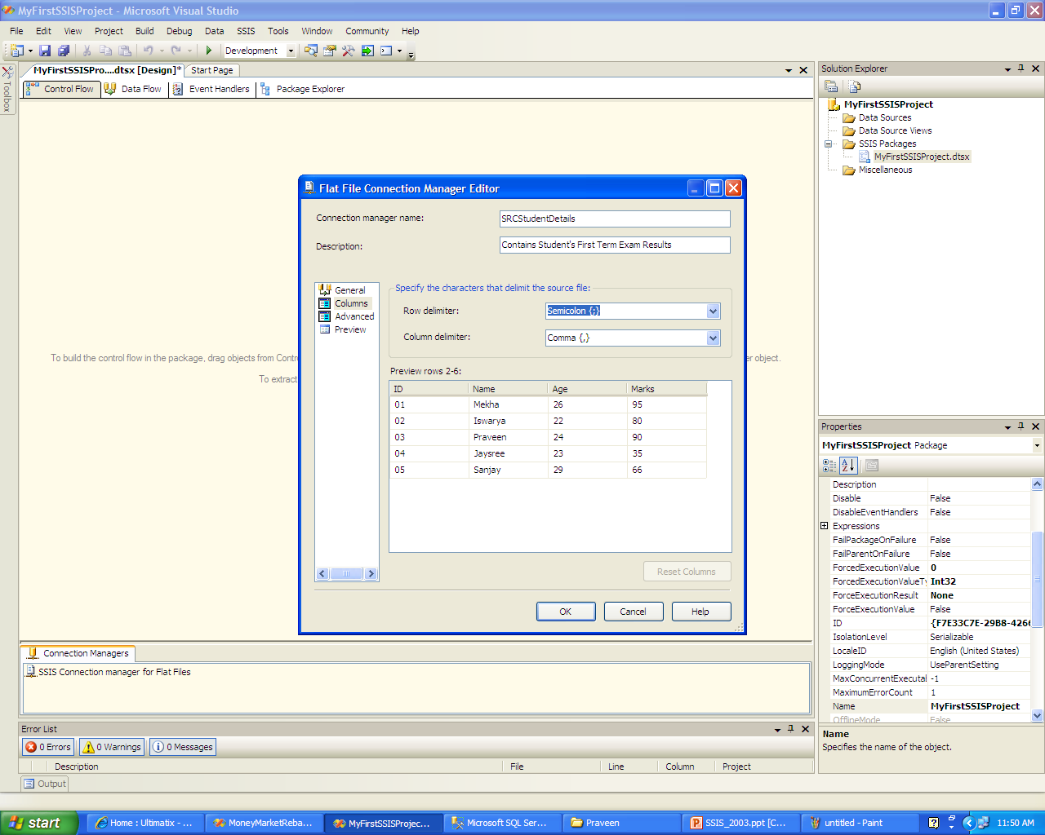
My First SSIS package … contd
Create a Flat File connection manager for source and OLE DB connection manager for Destination.
- ‹#› -

Slide 22
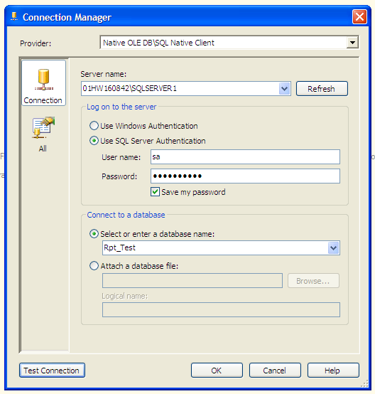
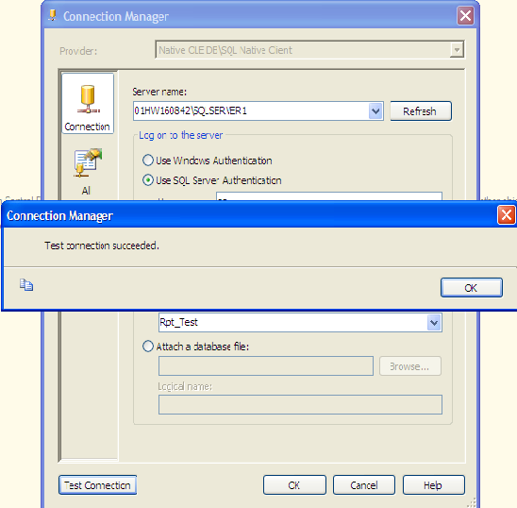

My First SSIS package … contd
- ‹#› -

Slide 23
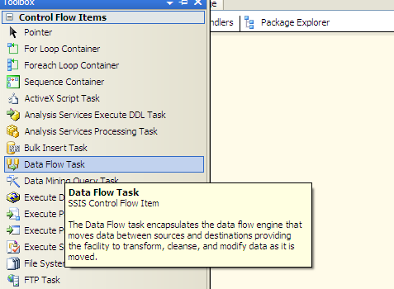
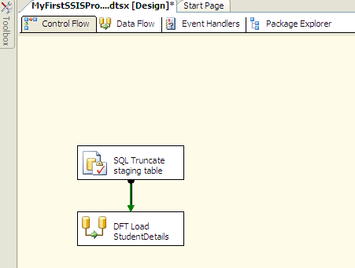
My First SSIS package … contd
On the Control flow Tab ToolBox, drag and drop Data Flow Task item on the Control Tab
- ‹#› -

Slide 24
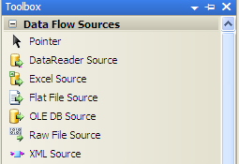
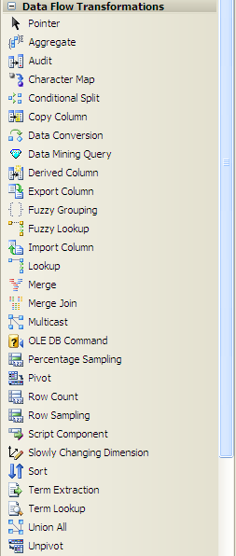
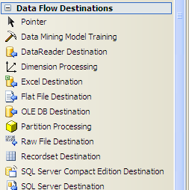
My First SSIS package … contd
On the Data flow Tab Tool Box, drag and drop Flat File Source from Data Flow Sources.
Then drag and drop Data Conversion Item from Data Flow Transformations
And finally drag and drop OLE DB Destination item from Data Flow Destinations
- ‹#› -

Slide 25
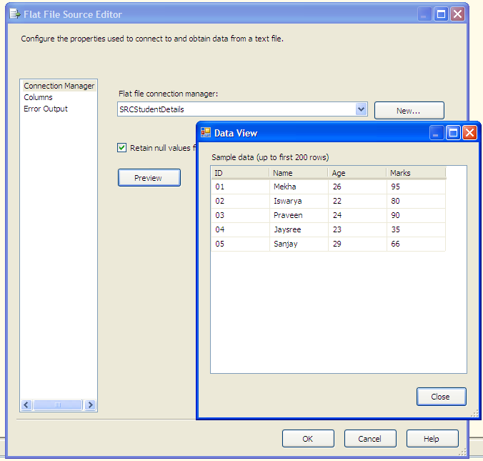
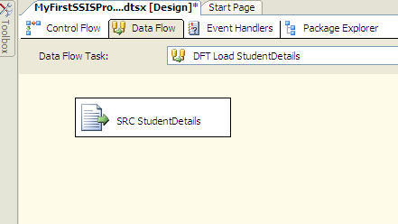
My First SSIS package … contd
Configure the Source, Transformation, Destination items.
Add a Derived Column from Transformation to include a new column called Result , include the formula as an expression and map to the Result coumn from dbo.StudentDetails on Destination item.
- ‹#› -

Slide 26
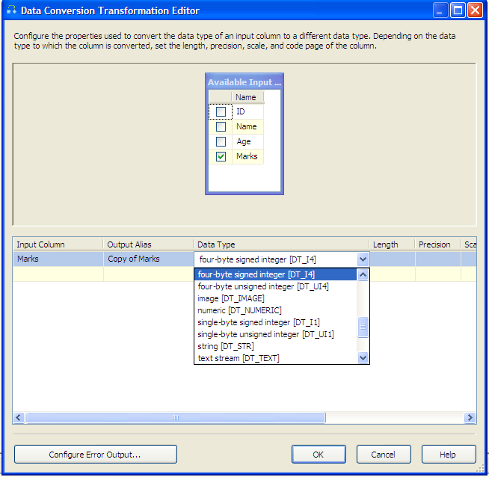
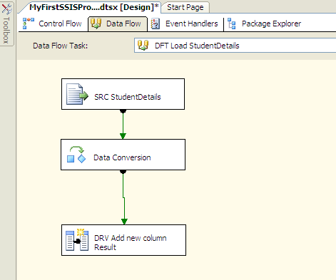
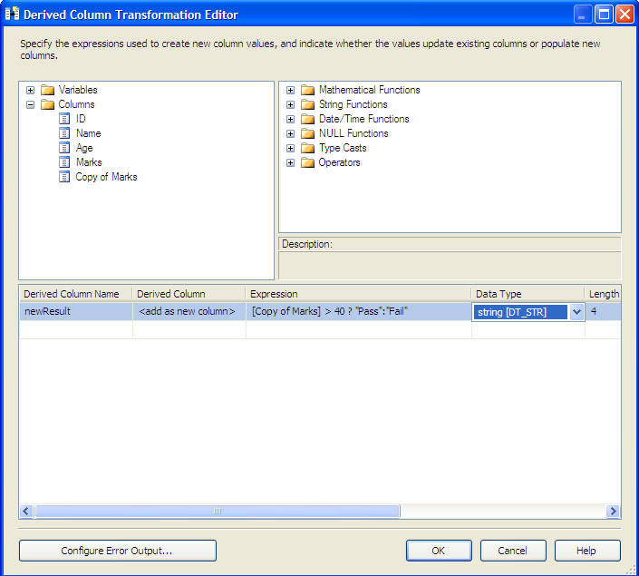
My First SSIS package … contd
Configure the Source, Transformation, Destination items.
Add a Derived Column from Transformation to include a new column called Result , include the formula as an expression and map to the Result coumn from dbo.StudentDetails on Destination item.
- ‹#› -

Slide 27
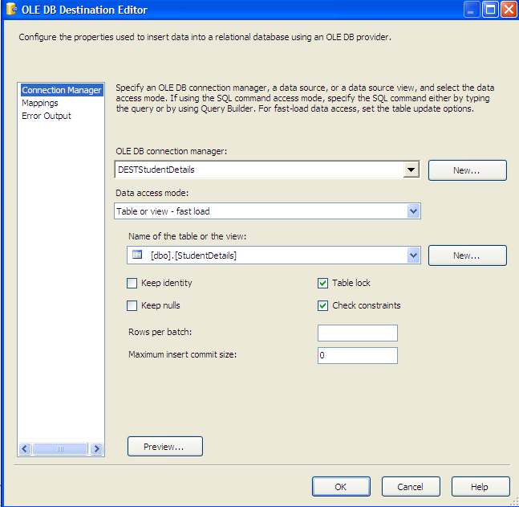
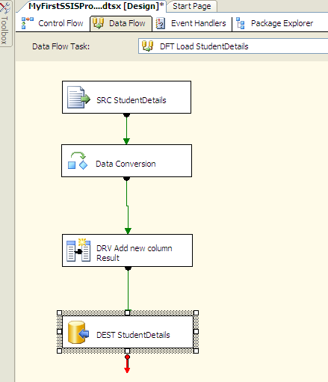
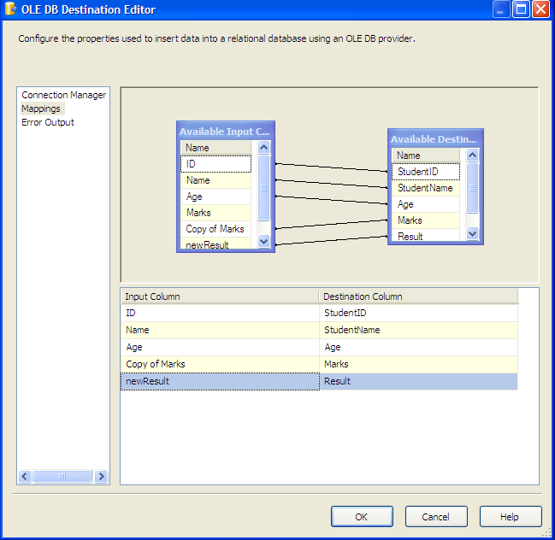
My First SSIS package … contd
Configure the Source, Transformation, Destination items.
Add a Derived Column from Transformation to include a new column called Result , include the formula as an expression and map to the Result coumn from dbo.StudentDetails on Destination item.
- ‹#› -

Slide 28
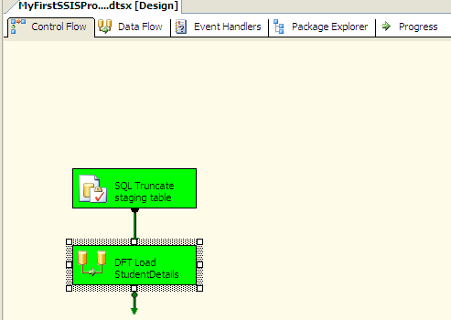
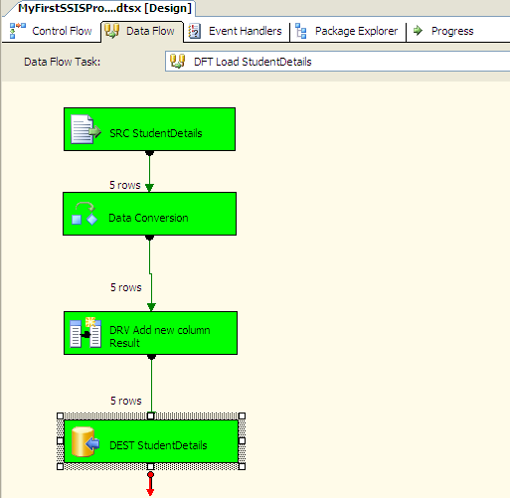
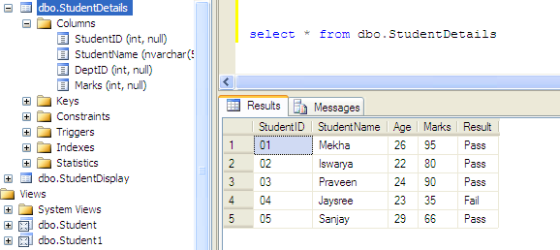
My First SSIS package … contd
Save the package and execute it by clicking on the green Play button at the top
- ‹#› -

Slide 29
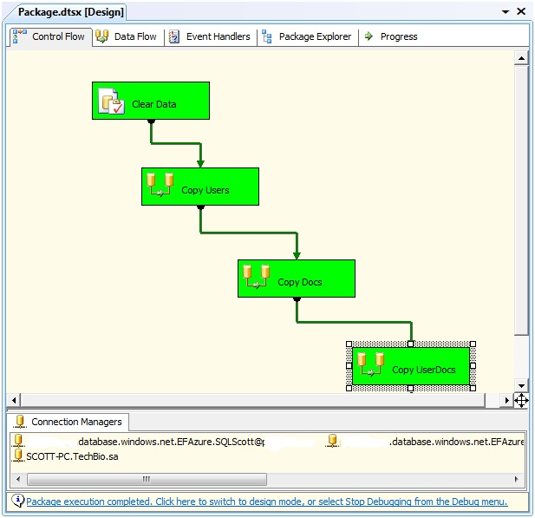
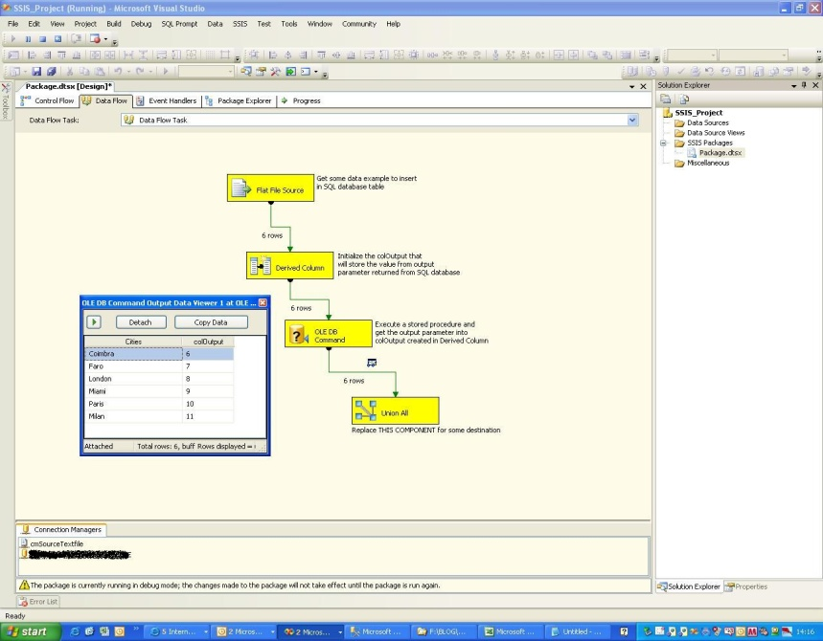
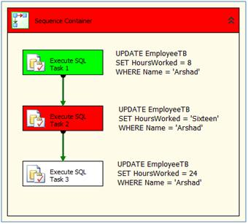
SSIS Package Deployment …. contd
Successful Execution
Execution in Progress
Execution Failure
- ‹#› -

Slide 30
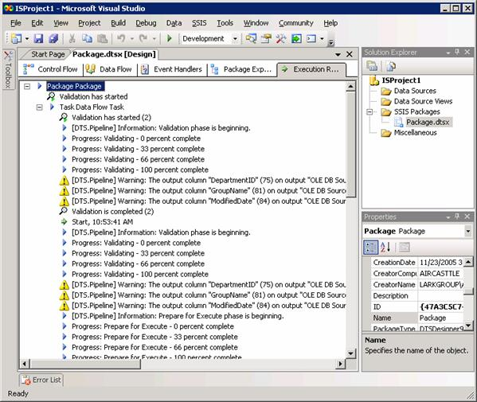
SSIS Package Deployment … contd
When the package runs, the Execution Results are shown as follows :
- ‹#› -

Slide 31
SSIS Package Deployment
Package Deployment can be done through various methods :
Using SQL Server Agent
When you create a SQL Server Agent job to run packages, you must create a separate step for each package that you want to run. The job can be associated with one or more schedules, or can be an unscheduled job that you run manually.
Using dtexec utility
This can be done from the command prompt.
After developing the package save and build it.
At the command prompt, type dtexec / followed by the DTS, SQL, or File option and the package path. Make sure to include the package file name in the package path.
- ‹#› -
Notes:
‹#›

Slide 32
SSIS Package Deployment
To create a package deployment utility, need to follow
In Business Intelligence Development Studio, open the solution that contains the Integration Services project for which you want to create a package deployment utility.
Right-click the project and click Properties.
In the <project name> Property Pages dialog box, click Deployment Utility.
To update package configurations when packages are deployed, set AllowConfigurationChanges to True.
Set CreateDeploymentUtility to True.
Optionally, update the location of the deployment utility by modifying the DeploymentOutputPath property.
In Solution Explorer, right-click the project, and then click Build.
View the build progress and build errors in the Output window.
- ‹#› -

Slide 33
SSIS Best Practices
Best Practice #1-> Always have a Staging Area
Best Practice #2-> Avoid SELECT *
Best Practice #3 - Effect of OLEDB Destination Settings
Data Access Mode
Keep Identity
Check Constraints
Best Practice #4-> Effect of Rows Per Batch and Maximum Insert Commit Size Settings
Rows per batch
Maximum insert commit size
Best Practice #5-> Use proper naming conventions for better readability
Data flow task – DFT
Source – SRC , Destination – DEST
Derived Column – DRV , Conditional Split – CSPL
Execute SQL Task – SQL , Multicast - MUL
- ‹#› -

Slide 34
References
http://msdn.microsoft.com/en-us/library/ms167031(v=SQL.90).aspx
http:// blog.sqlauthority.com by Pinal Dave
Professional SQL Server 2005 Integration Services
- ‹#› -

Slide 35
Thank You

